Slide 1
Applied Statistical Analysis
EDUC 6050
Week 6
Finding clarity using data

Slide 2
Today
Hypothesis Testing with T-tests
Confidence Intervals
Chapters 9 and 10 in Book

Slide 3
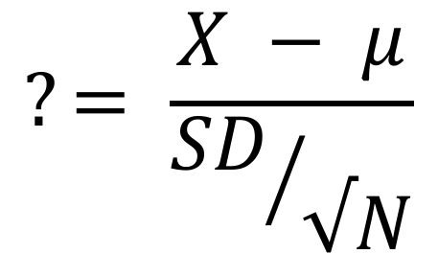
Review
$$?= \frac{X − μ}{{SD}/{√N}}$$
What test is this for
What situations can be do hypothesis testing for (before what we are talking about today)?
What types of t-tests did you read about this week?
3

Slide 4
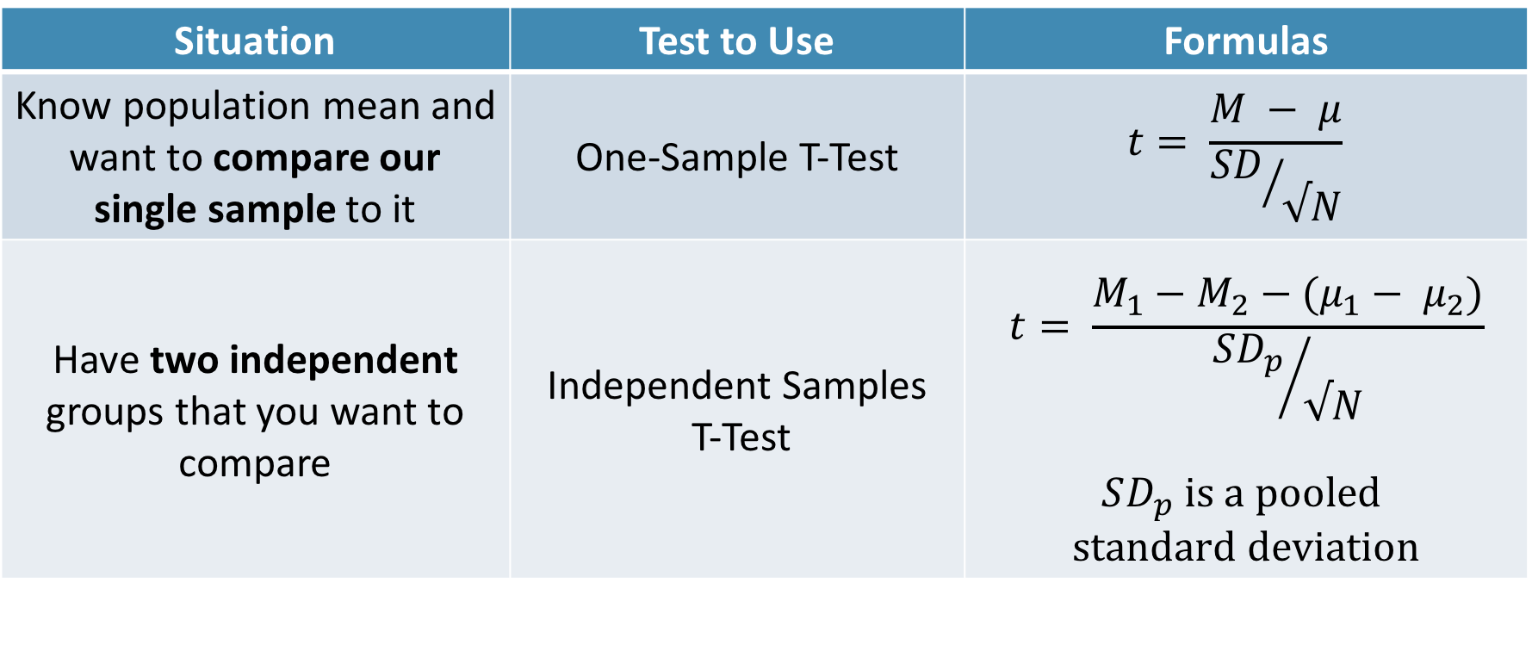
Independent Samples T-test
Situation | Test to Use | Formulas
Know population mean and want to compare our single sample to it | One-Sample T-Test | $$t= \frac{M − μ}{{SD}/{√N}}$$
Have two independent groups that you want to compare | Independent Samples T-Test | $$t= \frac{M_{1}−M_{2}−(μ_{1}− μ_{2})}{{SD_{p}}/{√N}}$$ $$SD_{p} is a pooled$$ $$standard deviation$$

Slide 5
Still using the same t-distribution
Notes:
As your sample size increases, the t gets closer and closer to the normal distribution

Slide 6
Requirements
ID | Outcome | Group
1 | 8 | 1
2 | 8 | 1
3 | 9 | 1
4 | 7 | 1
5 | 7 | 2
6 | 9 | 2
7 | 5 | 2
8 | 5 | 2
Need a DV on an interval/ratio scale,
IV defines two different groups
The groups are independent (not repeated measures)

Slide 7
Hypothesis Testing with T-Tests
The same 6 step approach!
Examine Variables to Assess Statistical Assumptions
State the Null and Research Hypotheses (symbolically and verbally)
Define Critical Regions
Compute the Test Statistic
Compute an Effect Size and Describe it
Interpreting the results

Slide 8
Examine Variables to Assess Statistical Assumptions
1
Basic Assumptions
Independence of data
Appropriate measurement of variables for the analysis
Normality of distributions
Homogeneity of variance

Slide 9
Examine Variables to Assess Statistical Assumptions
1
Basic Assumptions
Independence of data
Appropriate measurement of variables for the analysis
Normality of distributions
Homogeneity of variance
Individuals are independent of each other (one person’s scores does not affect another’s)

Slide 10
Examine Variables to Assess Statistical Assumptions
1
Basic Assumptions
Independence of data
Appropriate measurement of variables for the analysis
Normality of distributions
Homogeneity of variance
Here we need interval/ratio DV and an IV defines two groups
Notes:
For t-test, DV needs to be interval/ratio

Slide 11
Examine Variables to Assess Statistical Assumptions
1
Basic Assumptions
Independence of data
Appropriate measurement of variables for the analysis
Normality of distributions
Homogeneity of variance
The outcome needs to be normal (for small samples)

Slide 12
Examine Variables to Assess Statistical Assumptions
1
Basic Assumptions
Independence of data
Appropriate measurement of variables for the analysis
Normality of distributions
Homogeneity of variance
The variances of the two groups should be equal (although we can handle not equality)

Slide 13
Examine Variables to Assess Statistical Assumptions
1
Examining the Basic Assumptions
Independence: random sample
Appropriate measurement: know what your variables are
Normality: Histograms, skew and kurtosis
Homogeneity: Levene’s Test

Slide 14
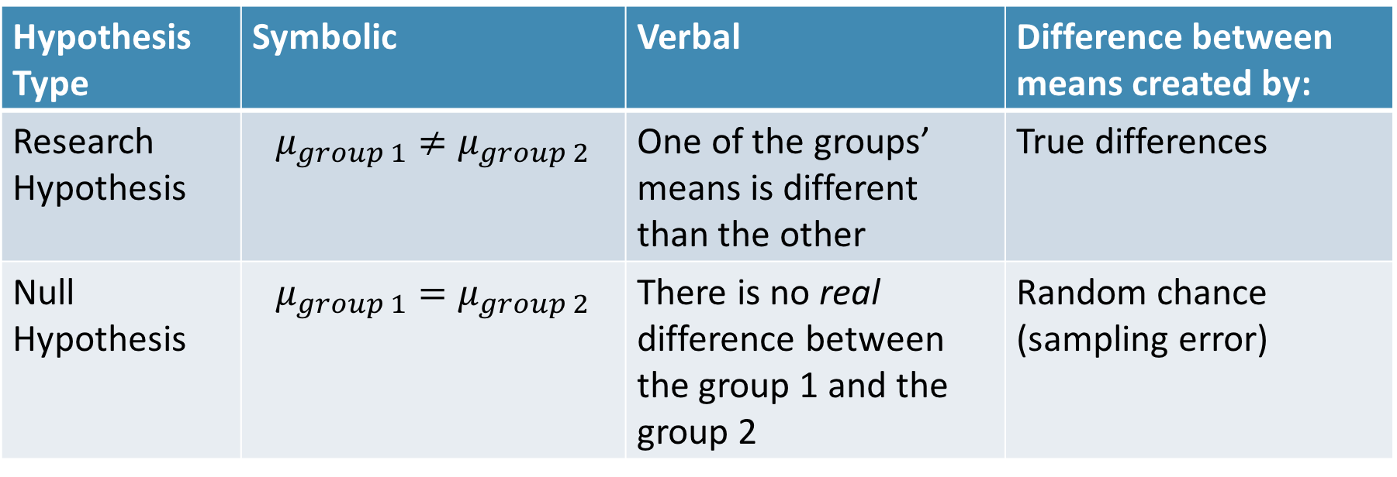
State the Null and Research Hypotheses (symbolically and verbally)
2
Hypothesis Type | Symbolic | Verbal | Difference between means created by:
Research Hypothesis | $$μ_{group 1}≠μ_{group 2}$$ | One of the groups’ means is different than the other | True differences
Null Hypothesis | $$μ_{group 1}=μ_{group 2}$$ | There is no real difference between the group 1 and the group 2 | Random chance (sampling error)
Notes:
Null and research hypotheses are mutually exclusive (they cover all possible outcomes)

Slide 15
Define Critical Regions
3
How much evidence is enough to believe the null is not true?
Before analyzing the data, we define the critical regions (generally based on an alpha = .05)

Slide 16
Define Critical Regions
3
We decide on an alpha level first
Then calculate the critical value (based on sample size)

Slide 17
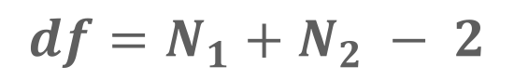
Define Critical Regions
3
We decide on an alpha level first
Then calculate the critical value (based on sample size)
I’ll provide a table for you for the t values
Base on alpha and a specific df
$$df=N_{1}+N_{2} − 2$$
Notes:
If our computed t value is beyond 2.05 OR our p-value is below .05, then we REJECT the null (the findings are statistically significant)

Slide 18

Define Critical Regions
3
We decide on an alpha level first
Then calculate the critical value (based on sample size)
I’ll provide a table for you for the t values
Base on alpha and a specific df
$$df=N −1$$
Notes:
If our computed t value is beyond 2.05 OR our p-value is below .05, then we REJECT the null (the findings are statistically significant)

Slide 19


Define Critical Regions
3
We decide on an alpha level first
Then calculate the critical value (based on sample size)
$$t_{critical, 29}=2.05$$
So our critical regions is defined as:
$$α= .05$$
$$t_{critical, 29}=2.05$$
Notes:
If our computed t value is beyond 2.05 OR our p-value is below .05, then we REJECT the null (the findings are statistically significant)

Slide 20
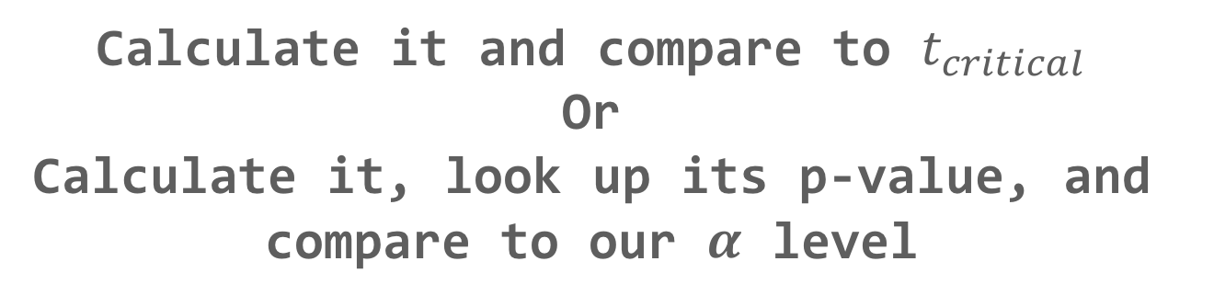
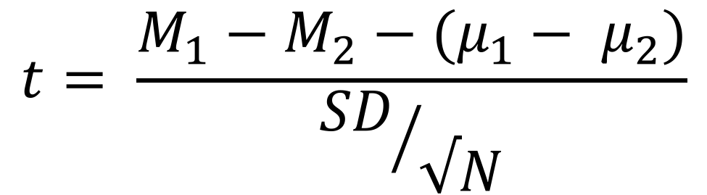
Compute the Test Statistic
4
$$t= \frac{M_{1}−M_{2}−(μ_{1}− μ_{2})}{{SD}/{√N}}$$
The SEM, $μ$, and M will be given to you
Calculate it and compare to $t_{critical}$
Or
Calculate it, look up its p-value, and compare to our $α$ level

Slide 21
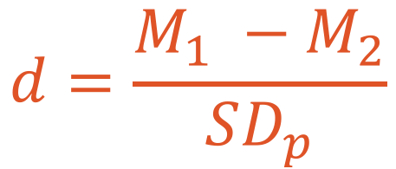
Compute an Effect Size and Describe it
5
One of the main effect size estimates is Cohen’s d
$$d=\frac{M_{1} −M_{2}}{SD_{p}}$$
d | Estimated Size of the Effect
Close to .2 | Small
Close to .5 | Moderate
Close to .8 | Large

Slide 22
Interpreting the results
6
Put your results into words
Use the example on page XX as a template

Slide 23
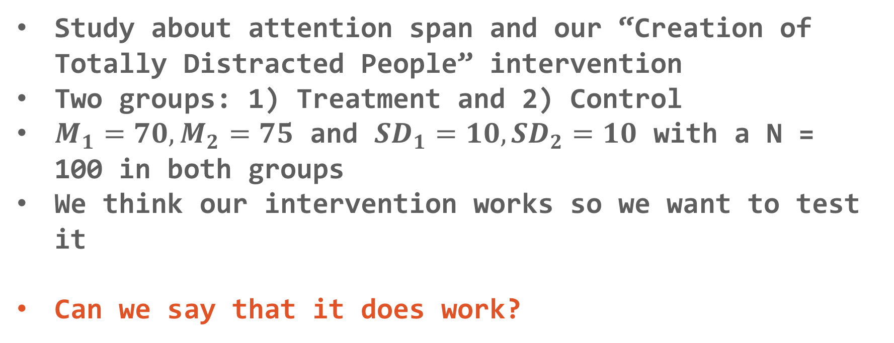
Independent Samples T-test
Let’s practice!
Study about attention span and our “Creation of Totally Distracted People” intervention
Two groups: 1) Treatment and 2) Control
$M_{1}=70, M_{2}=75$ and $SD_{1}=10, SD_{2}=10$ with a N = 100 in both groups
We think our intervention works so we want to test it
Can we say that it does work?

Slide 24
Let’s use
Jamovi
Independent Samples T-test

Slide 25
Break Time

Slide 26
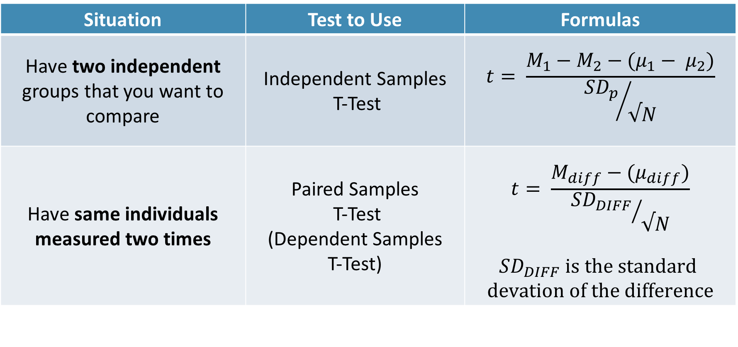
Paired Samples T-test
Situation | Test to Use | Formulas
Have two independent groups that you want to compare | Independent Samples T-Test | $$t= \frac{M_{1}−M_{2}−(μ_{1}− μ_{2})}{{SD_{p}}/{√N}}$$
Have same individuals measured two times | Paired Samples T-Test (Dependent Samples T-Test) | $$t= \frac{M_{diff}−(μ_{diff})}{{SD_{DIFF}}/{√N}}$$ $$SD_{DIFF} is the standard$$ $$devation of the difference$$

Slide 27
Requirements
ID | Time 1 | Time 2
1 | 8 | 7
2 | 8 | 8
3 | 9 | 6
4 | 7 | 6
5 | 7 | 8
6 | 9 | 5
7 | 5 | 3
8 | 5 | 3
Need a DV on an interval/ratio scale,
IV defines two time points
Same individuals measured twice

Slide 28
Examine Variables to Assess Statistical Assumptions
1
Basic Assumptions
Independence of data
Appropriate measurement of variables for the analysis
Normality of distributions
Homogeneity of variance

Slide 29
Examine Variables to Assess Statistical Assumptions
1
Basic Assumptions
Independence of data
Appropriate measurement of variables for the analysis
Normality of distributions
Homogeneity of variance
Individuals are independent of each other (one person’s scores does not affect another’s)

Slide 30
Examine Variables to Assess Statistical Assumptions
1
Basic Assumptions
Independence of data
Appropriate measurement of variables for the analysis
Normality of distributions
Homogeneity of variance
Here we need two interval/ratio DVs (one for each time point)
Notes:
For t-test, DV needs to be interval/ratio

Slide 31
Examine Variables to Assess Statistical Assumptions
1
Basic Assumptions
Independence of data
Appropriate measurement of variables for the analysis
Normality of distributions
Homogeneity of variance
The outcome needs to be normal (for small samples)

Slide 32
Examine Variables to Assess Statistical Assumptions
1
Basic Assumptions
Independence of data
Appropriate measurement of variables for the analysis
Normality of distributions
Homogeneity of variance
The variances of the two time points should be equal

Slide 33
Examine Variables to Assess Statistical Assumptions
1
Examining the Basic Assumptions
Independence: random sample
Appropriate measurement: know what your variables are
Normality: Histograms, skew and kurtosis
Homogeneity: Levene’s Test

Slide 34
State the Null and Research Hypotheses (symbolically and verbally)
2
Hypothesis Type | Symbolic | Verbal | Difference between means created by:
Research Hypothesis | $$μ_{group 1}≠μ_{group 2}$$ | One of the groups’ means is different than the other | True differences
Null Hypothesis | $$μ_{group 1}=μ_{group 2}$$ | There is no real difference between the group 1 and the group 2 | Random chance (sampling error)
Notes:
Null and research hypotheses are mutually exclusive (they cover all possible outcomes)

Slide 35
Define Critical Regions
3
How much evidence is enough to believe the null is not true?
Before analyzing the data, we define the critical regions (generally based on an alpha = .05)

Slide 36
Define Critical Regions
3
We decide on an alpha level first
Then calculate the critical value (based on sample size)

Slide 37
Define Critical Regions
3
We decide on an alpha level first
Then calculate the critical value (based on sample size)
I’ll provide a table for you for the t values
Base on alpha and a specific df
$$df=N_{1}+N_{2} − 2$$
Notes:
If our computed t value is beyond 2.05 OR our p-value is below .05, then we REJECT the null (the findings are statistically significant)

Slide 38
Define Critical Regions
3
We decide on an alpha level first
Then calculate the critical value (based on sample size)
I’ll provide a table for you for the t values
Base on alpha and a specific df
$$df=N_{1}+N_{2} − 2$$
Notes:
If If our computed t value is beyond 2.05 OR our p-value is below .05, then we REJECT the null (the findings are statistically significant)

Slide 39
Define Critical Regions
3
We decide on an alpha level first
Then calculate the critical value (based on sample size)
$$t_{critical, 29}=2.05$$
So our critical regions is defined as:
$$α= .05$$
$$t_{critical, 29}=2.05$$
Notes:
If our computed t value is beyond 2.05 OR our p-value is below .05, then we REJECT the null (the findings are statistically significant)

Slide 40
Compute the Test Statistic
4
$$t= \frac{M_{1}−M_{2}−(μ_{1}− μ_{2})}{{SD}/{√N}}$$
The SEM, $μ$, and M will be given to you
Calculate it and compare to $t_{critical}$
Or
Calculate it, look up its p-value, and compare to our $α$ level

Slide 41
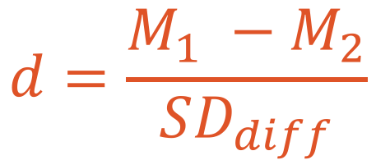
Compute an Effect Size and Describe it
5
One of the main effect size estimates is Cohen’s d
$$d=\frac{M_{1} −M_{2}}{SD_{diff}}$$
d | Estimated Size of the Effect
Close to .2 | Small
Close to .5 | Moderate
Close to .8 | Large

Slide 42
Interpreting the results
6
Put your results into words
Use the example on page XX as a template

Slide 43
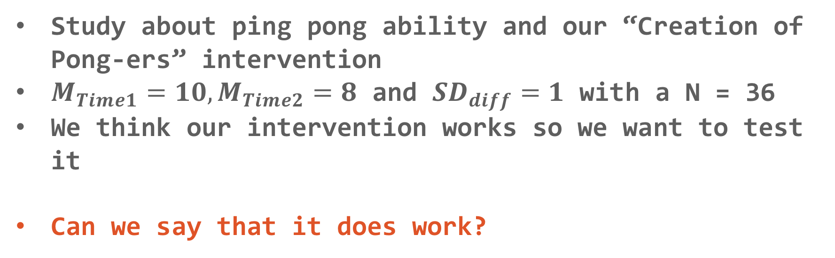
Related Samples T-test
Let’s practice!
Study about ping pong ability and our “Creation of Pong-ers” intervention
$M_{Time1}=10, M_{Time2}=8$ and $SD_{diff}=1$ with a N = 36
We think our intervention works so we want to test it
Can we say that it does work?

Slide 44
Break Time

Slide 45
Confidence Intervals
CI
Theory Behind It

Slide 46

Confidence Intervals
CI
How we use it
Our Estimate
Lower Bound
Upper Bound
$$Estimate±t_{critical}∗SE_{est}$$

Slide 47
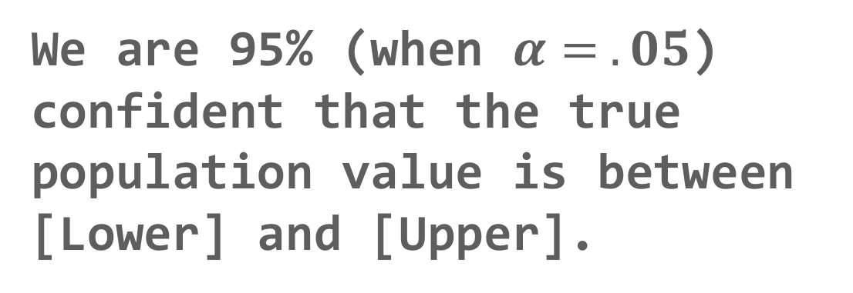
Confidence Intervals
CI
Our Estimate
Lower Bound
Upper Bound
We are 95% (when $α= .05$) confident that the true population value is between [Lower] and [Upper].
Interpretation:

Slide 48
Confidence Intervals
Let’s practice!
Study about attention span and our “Creation of Totally Distracted People” intervention
Two groups: 1) Treatment and 2) Control
$M_{1}=70, M_{2}=75$ and $SD_{1}=10, SD_{2}=10$ with a N = 100 in both groups
We think our intervention works so we want to test it
Can we say that it does work?

Slide 49
Let’s use
Jamovi
Confidence Intervals

Slide 50
Questions?

Slide 51
Next week:
Intro to ANOVA
Chapter 11 in Book
Keep updating your Statistical Organizer

